Slide 1
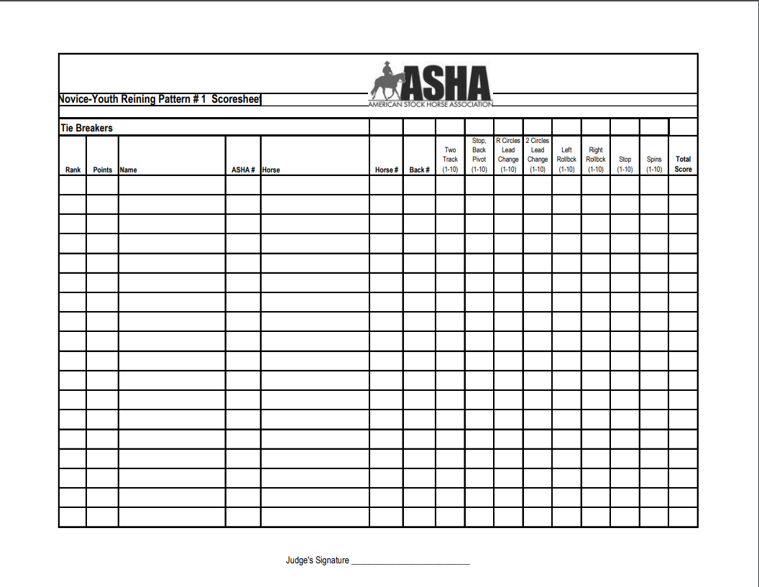


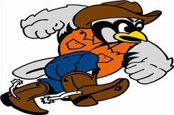





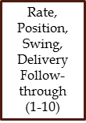
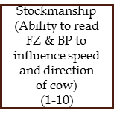
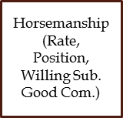


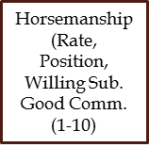
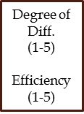
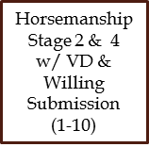
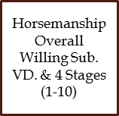

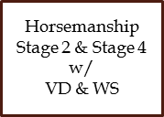
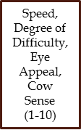
Working Cow Horse Level 2
TVCC Stock Horse Team
Reining Phase 1: Walk/ Trot
TVCC Stock Horse Team
Arena Work
Box Cow
Pen Cow
Rope Dummy

Slide 2
Working Cow Horse Level 2
TVCC Stock Horse Team
Reining Phase 1: Trot/ Ext. Trot
TVCC Stock Horse Team
Arena Work
Box Cow
Pen Cow
Rope Dummy

Slide 3
Working Cow Horse Level 2
TVCC Stock Horse Team
Reining Phase 3: Lope/Simple Lead
TVCC Stock Horse Team
Arena Work
Box Cow
Pen Cow
Rope Dummy

Slide 4
Working Cow Horse Level 2
TVCC Stock Horse Team
Reining Phase 4: Lope/ Flying Lead
TVCC Stock Horse Team
Arena Work
Box Cow
Pen Cow
Rope Dummy

